Slide 1
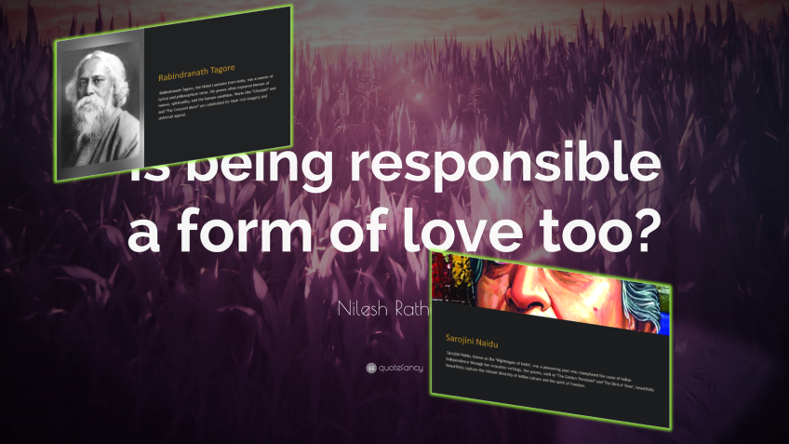

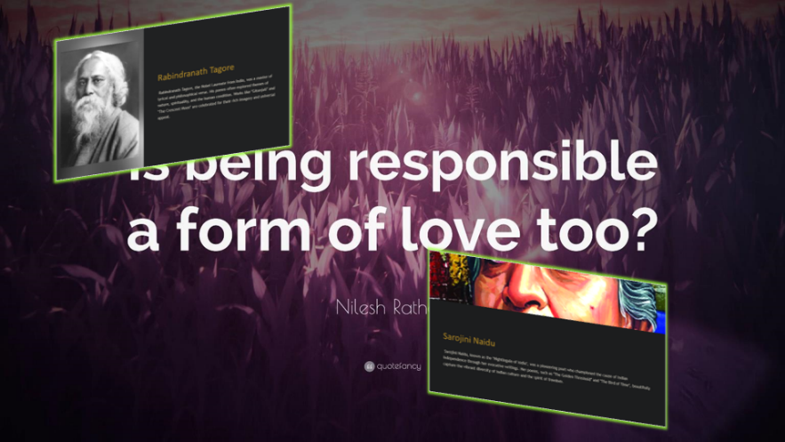

Exploring the Poetic Voices of India and America
This presentation will dive into the powerful poetic works of two renowned Indian poets - Rabindranath Tagore and Sarojini Naidu - and two celebrated American poets - Emily Dickinson and Walt Whitman. We will explore their distinct themes, styles, and cultural influences that have made them timeless voices in world literature.
by Sarthak Kumar
INDIAN POETS
AMERICAN POETS

Slide 2

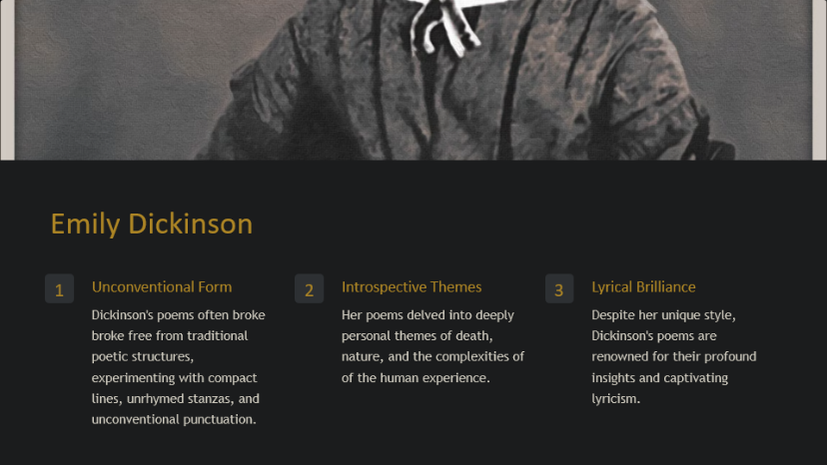
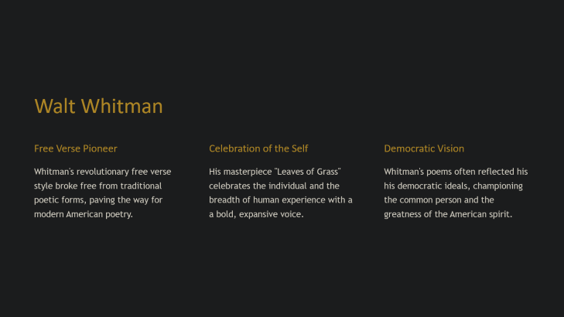
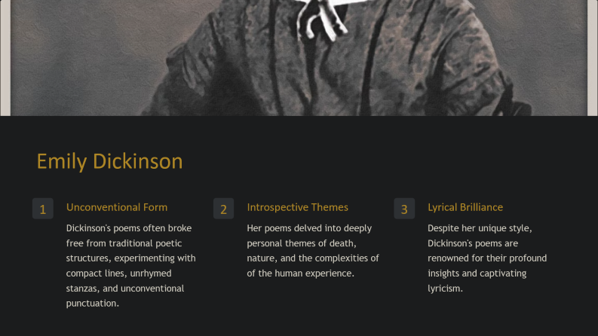


Slide 3


Emily Dickinson
1
Unconventional Form
2
Introspective Themes
3
Lyrical Brilliance
Dickinson's poems often broke free from traditional poetic structures, experimenting with compact lines, unrhymed stanzas, and unconventional punctuation.
Her poems delved into deeply personal themes of death, nature, and the complexities of the human experience.
Despite her unique style, Dickinson's poems are renowned for their profound insights and captivating lyricism.

Slide 4
Walt Whitman
Free Verse Pioneer
Celebration of the Self
Democratic Vision
Whitman's revolutionary free verse style broke free from traditional poetic forms, paving the way for modern American poetry.
His masterpiece "Leaves of Grass" celebrates the individual and the breadth of human experience with a bold, expansive voice.
Whitman's poems often reflected his democratic ideals, championing the common person and the greatness of the American spirit.

Slide 5
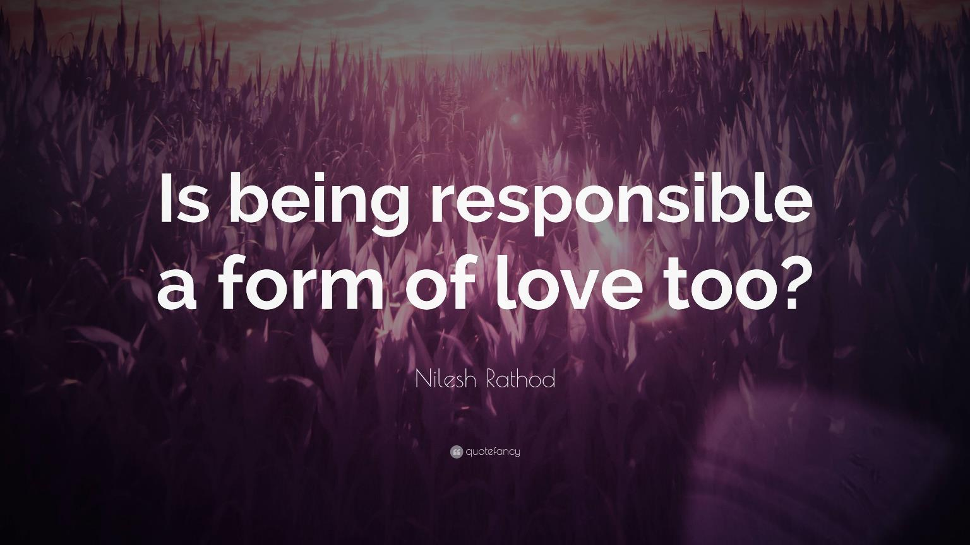
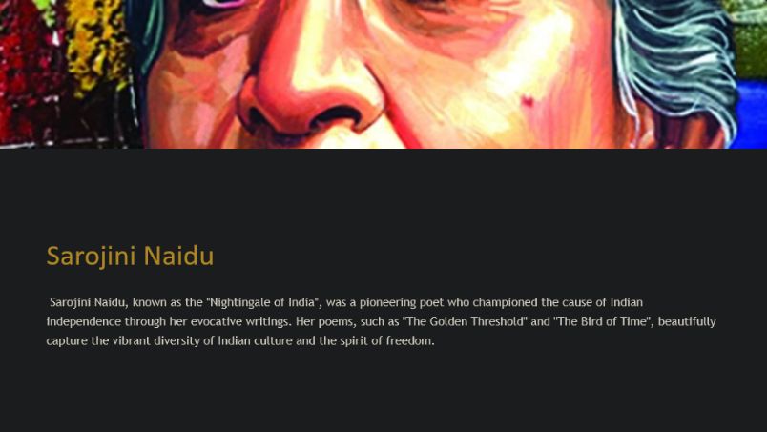
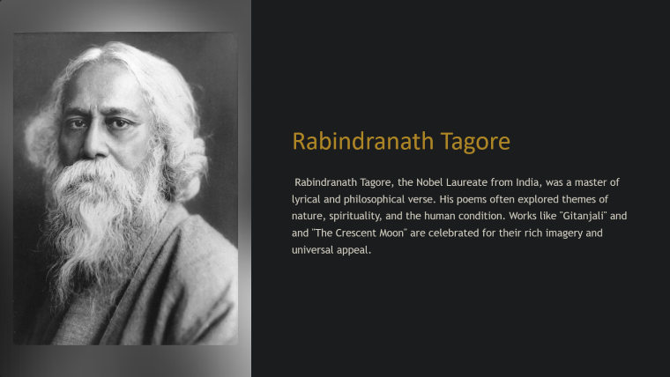



Slide 6

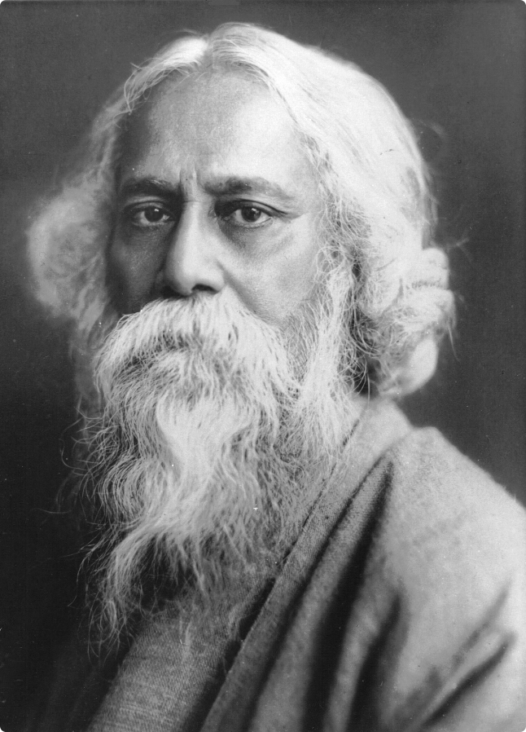
Rabindranath Tagore
Rabindranath Tagore, the Nobel Laureate from India, was a master of lyrical and philosophical verse. His poems often explored themes of nature, spirituality, and the human condition. Works like "Gitanjali" and "The Crescent Moon" are celebrated for their rich imagery and universal appeal.

Slide 7
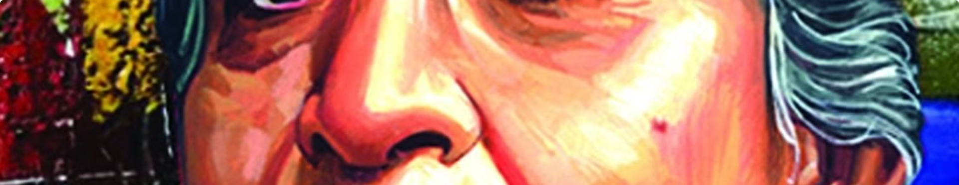
Sarojini Naidu
Sarojini Naidu, known as the "Nightingale of India", was a pioneering poet who championed the cause of Indian independence through her evocative writings. Her poems, such as "The Golden Threshold" and "The Bird of Time", beautifully capture the vibrant diversity of Indian culture and the spirit of freedom.

Slide 8


Comparative Analysis: Themes and Styles
1
Lyrical Mastery
Tagore, Naidu, Dickinson, and Whitman all demonstrated exceptional command of poetic language, crafting vivid imagery and emotional resonance.
2
Philosophical Depth
Their poems delved into profound questions of the human condition, exploring themes of spirituality, identity, and the natural world.
3
Experimental Voices
While Tagore and Naidu worked within traditional Indian poetic forms, Dickinson and Whitman pioneered new, unconventional styles.

Slide 9


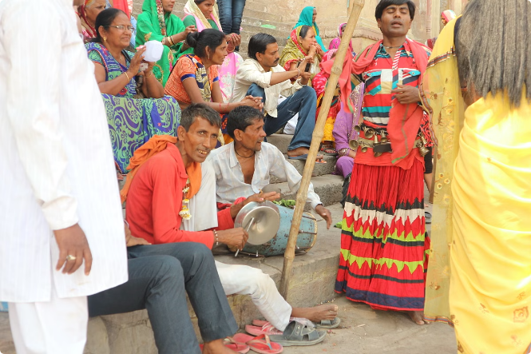


Cultural Influences and Inspirations
Indian Roots
Tagore and Naidu's poems were deeply rooted in the rich cultural and spiritual traditions of India, reflecting the country's diverse heritage.
American Landscape
Dickinson and Whitman's works were profoundly shaped by the vast, awe-inspiring landscapes of the United States, from the rolling prairies to the bustling cities.
Philosophical Muses
All four poets were influenced by the deep philosophical traditions of their respective cultures, which infused their writings with a sense of contemplation and transcendence.

Slide 10




Conclusion: The Universality of Poetry
Diverse Voices
Common Threads
Timeless Impact
Tagore, Naidu, Dickinson, and Whitman represent the rich diversity of poetic expression across India and America.
Yet, their works are united by their shared ability to capture the universal human experience through the power of language.
The enduring legacy of these poets continues to inspire and captivate readers around the world, transcending cultural boundaries.

Slide 11


Thank You

